Slide 1

SAP Portfolio
Scott Miller

Slide 2
Table of Contents
3 - Introduction
4 - Creating an Inquiry
5 & 6 - Completing Purchasing Cycle
7 & 8 - Creating Sales Order from Inquiry
9 - Receiving Payment
10 - Credit Adjustment
11 - Sales Order that Exceeds Credit Limit
12 - Release Blocked Sales Order
13 - Bill of Materials
14 - Product Groups
15- Rough-Cut Plan – Sales Forecast

Slide 3
Introduction
During my time at Durham College, I completed the course “Introduction to Business Processes” (COMP3204). This course specifically focused on the uses of SAP and how it can benefit companies on organization and efficiency.
We used an imitation software originated out of the University of Milwaukee that allowed us to create our own company and practice using SAP to complete certain tasks that would be required to perform in the field of work. The company that was created was called “Fitter Snacker” which manufactures and distributes two different energy bars, NRG-A and NRG-B.
In the following slides, I will show examples of what was completed during this course and brief descriptions of the significance of each example. This should demonstrate my knowledge and ability to maneuver around the software comfortably and efficiently.

Slide 4
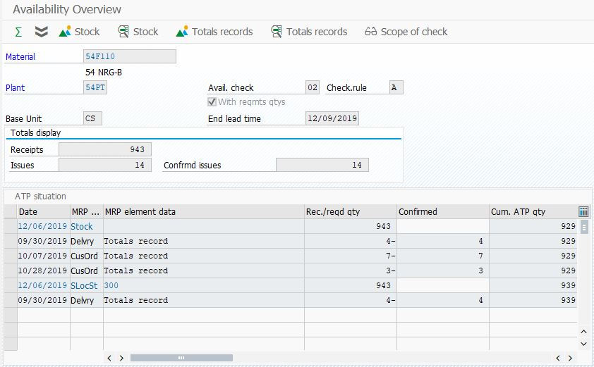
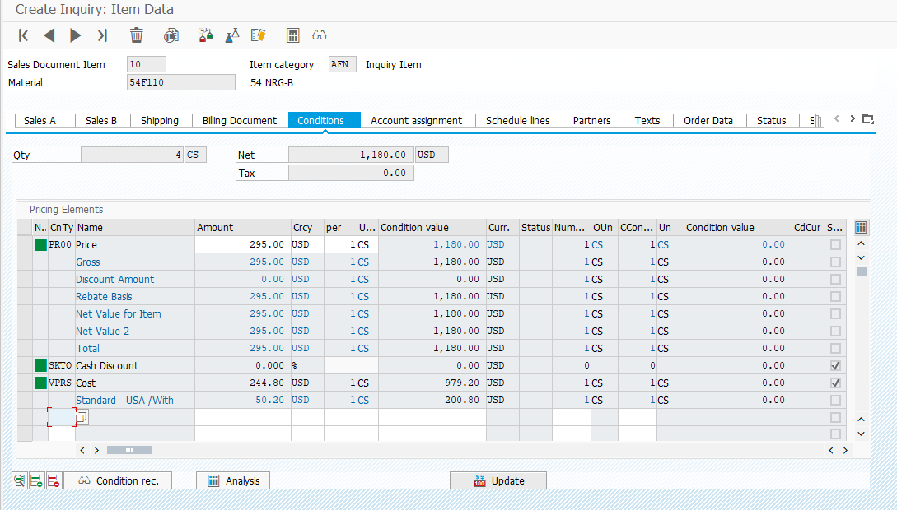
Inquiry
Task: Meijer, Inc. is a customer in the wholesale distribution channel. They would like to know whether you have 4 cases of NRG-B bars in stock, and how much they would pay for them, and whether they are eligible for any discounts.
This screenshot shows that there are currently 939 available units of NRG-B to sell stored at storage location 300.
This screenshot shows that it would cost Meijer Inc. $1,180.00 to purchase 4 cases of NRG-B. Also, it shows that there would be no customer discount applied to the purchase

Slide 5
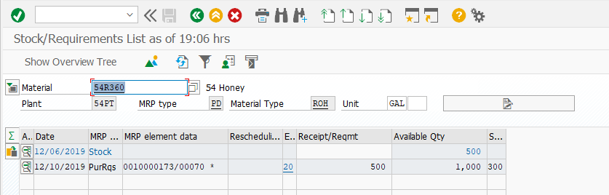
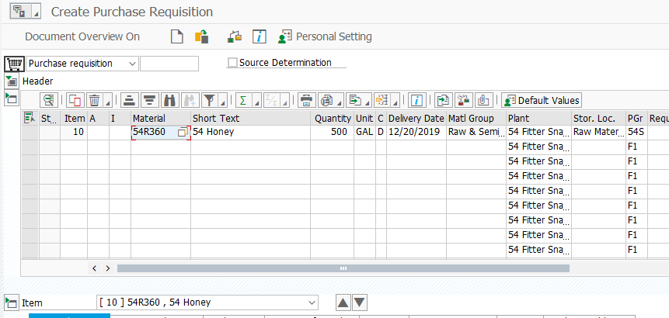
Purchasing Cycle
Task: You have heard that there is a projected worldwide shortage of honey. Start by showing how much honey you currently have in stock. Then, imagine you work for the SPECIALTY purchasing group. Complete the entire purchasing cycle, including requisition, purchase order, goods receipt, invoice receipt, and payment for 500 gallons of honey from the supplier of your choice. You want the honey to be available in 2 weeks from today. Be sure to DOCUMENT EACH of the key steps in the purchasing cycle. Then, show another screenshot showing how much honey you NOW have in stock and proving that you have increased the inventory by 500 gallons.
This screenshot shows that there are 500 units of honey currently in stock.
This screenshot shows that the requisition for the honey has been created. This allows us to create a purchase order easily by using the purchase requisition as reference.

Slide 6
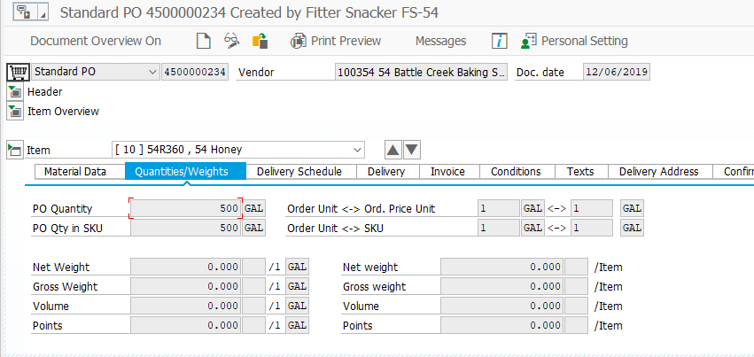
Purchasing Cycle cont’d
Task: You have heard that there is a projected worldwide shortage of honey. Start by showing how much honey you currently have in stock. Then, imagine you work for the SPECIALTY purchasing group. Complete the entire purchasing cycle, including requisition, purchase order, goods receipt, invoice receipt, and payment for 500 gallons of honey from the supplier of your choice. You want the honey to be available in 2 weeks from today. Be sure to DOCUMENT EACH of the key steps in the purchasing cycle. Then, show another screenshot showing how much honey you NOW have in stock and proving that you have increased the inventory by 500 gallons.
This screenshot shows that a purchase order was created using the purchase requisition that was made earlier. It was saved with the number 4500000234.

Slide 7
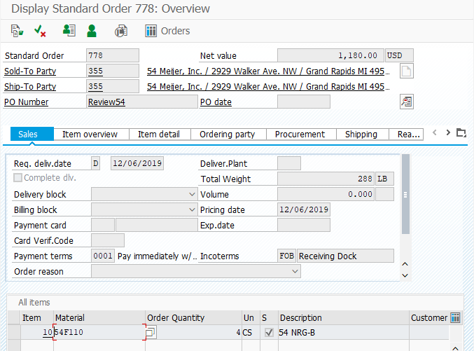
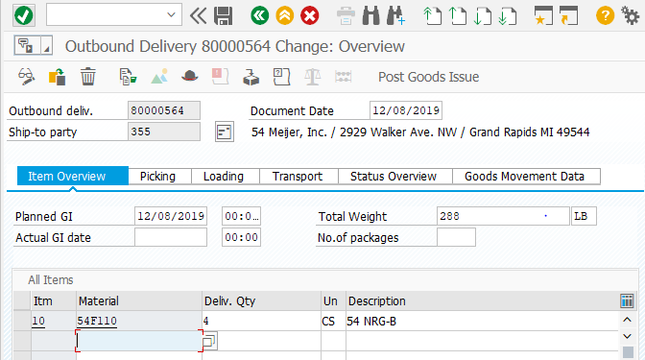
Create Sales Order from Inquiry
Task: Meijer, Inc. calls back and wants to buy the 4 cases of NRG-B that they called you about previously. Their PO # that they give you is Review##. Sell them the 4 cases, send the goods to them, send the invoice to them. Document the key steps of this process. Be sure to point out how much this order will this cost them. Use views of the document flow to show the status of this customer order as it makes its way through the various stages of the fulfilment process.
This screenshot shows that an outbound delivery has been created to deliver the goods to the customer
This screenshot shows that the sales order was created with reference to the inquiry that was received earlier from this company

Slide 8
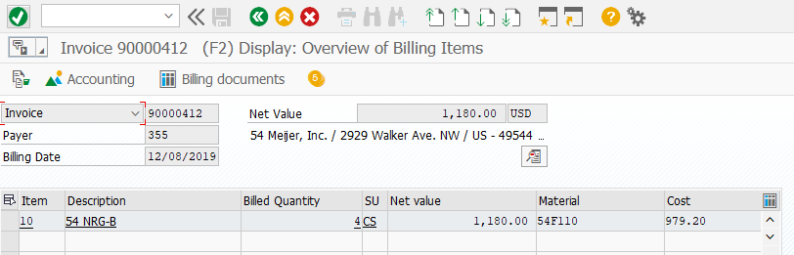
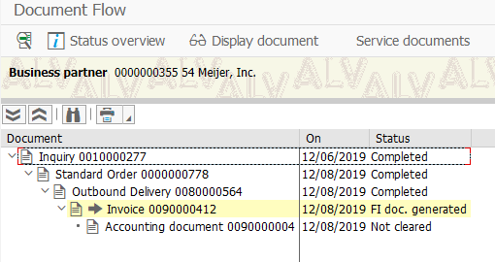
Create Sales Order from Inquiry cont’d
Task: Meijer, Inc. calls back and wants to buy the 4 cases of NRG-B that they called you about previously. Their PO # that they give you is Review##. Sell them the 4 cases, send the goods to them, send the invoice to them. Document the key steps of this process. Be sure to point out how much this order will this cost them. Use views of the document flow to show the status of this customer order as it makes its way through the various stages of the fulfilment process.
This screenshot shows that the invoice for the customer Meijer Inc. has been created for the order of 4 cases
This screenshot shows the document flow of the order. This provides detail on the steps the sales process has completed and what step it is currently in

Slide 9
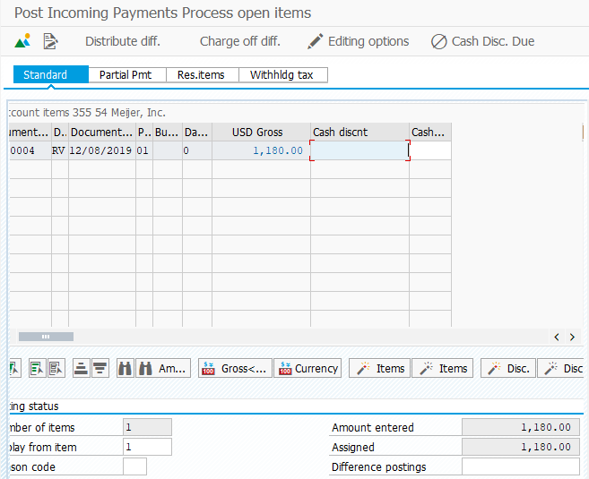
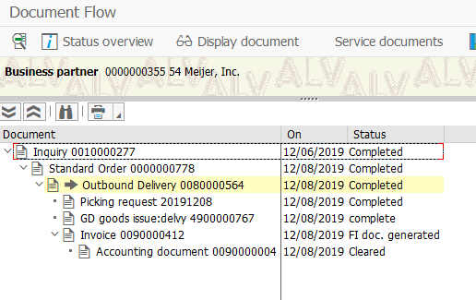
Receiving Payment
Task: You have just received a cheque from Meijer, Inc. in full payment of the invoice that you sent them for their order of 4 cases of NRG-B bars. Document in the SAP system that this cheque has arrived and show the document flow screen that proves that you have posted this payment to their account with you.
This screenshot shows that the payment has been entered into the system, covering the outstanding balance of $1,180.00.
This screenshot shows the document flow of the order, proving that the payment has been accepted and completed for the order.

Slide 10
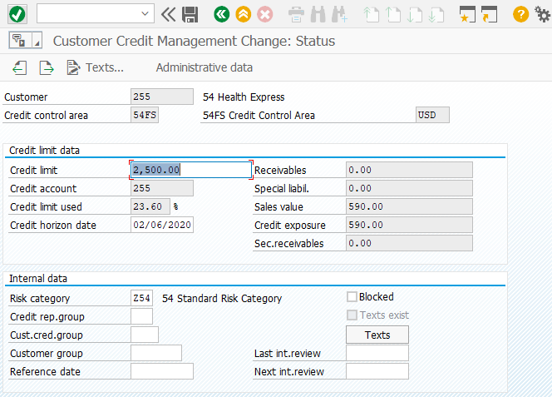
Credit Adjustment
Task: You work in the Fitter Snacker credit department. You have been asked to adjust the credit limit for Health Express to $2500.
This screenshot shows that the credit limit for Health Express has been changed from $1000.00 to $2500.00.

Slide 11
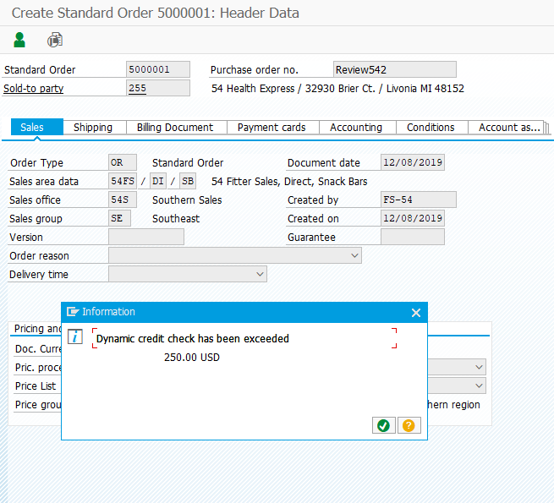
Sales Order that Exceeds Credit Limit
Task: Health Express calls to order 9 cases of NRG-B. Health Express is a customer in the DIRECT distribution channel. Create the sales order for them, being sure to explain what is happening from the standpoint of credit management.
This screenshot shows that by creating a sales order for 9 cases of NRG-A, Health Express’ credit limit has been exceeded by $250.00. SAP will not allow the user to continue the process until the credit limit is changed or the order is allowed to pass by the stoppage which would need to be entered manually.

Slide 12
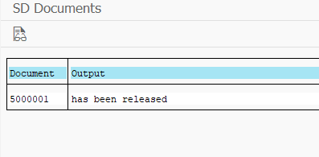
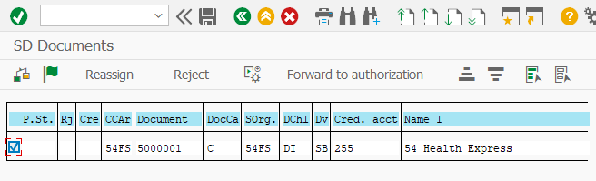
Release Blocked Sales Order
Task: You are an employee in the credit management department. Release the blocked sales order for Health Express from step 7 above, then proceed to give responsibility for this order to the warehouse. Do not take the order through the entire fulfilment process. Just do the “hand off” to the warehouse, and prove that the order is now awaiting picking.
This screenshot shows that the order has officially been released and is now ready to process.
This screenshot shows that the order for Health Express that exceeds the credit limit is about to be released by clicking on the release button.

Slide 13
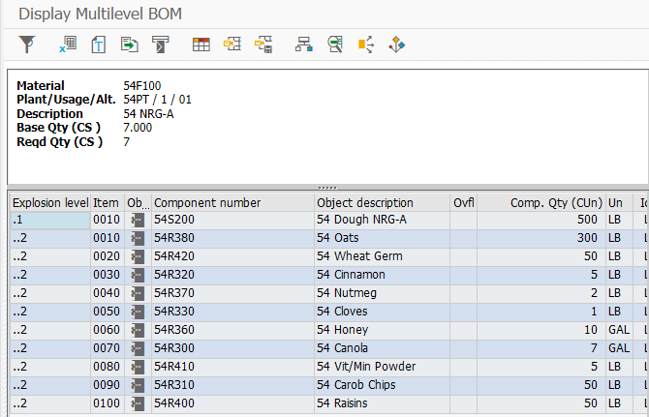
Bill of Materials (BOM)
Task: Display the bill of material (BOM) for your NRG-A bars. Provide a brief explanation that proves you know what a BOM is and what this particular BOM is saying about how NRG-A bars are made.
This screenshot shows the multilevel bill of materials for NRG-A bars. A BOM is a list of the materials necessary to manufacture a desired end product. In this picture, you can clearly see the ingredients that are required to produce NRG-A bars.

Slide 14
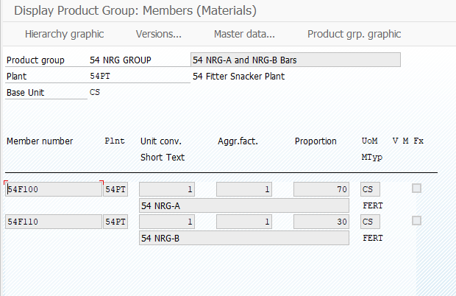
Product Group
Task: You previously created the NRG Group. Display the details of how that product group is structured, and explain the purpose of this product group in the Fitter Snacker organization.
This screenshot shows the NRG group for both NRG-A and NRG-B bars. The proportion is 70% NRG-A and 30% NRG-B. The purpose of creating these product groups is to plan production for small numbers of product groups and then transfer these plans to individual products based on their previous percentages.

Slide 15
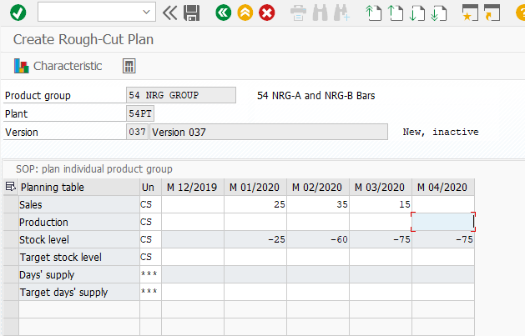
Rough-Cut Plan – Sales Forecast
Task: You have just attended an SOP meeting and it has been decided that our “best guess” sales forecast for our NRG product group is as follows:
1 month in future - 25 cases
2 months in future - 35 cases
3 months in future - 15 cases
This screenshot shows that the appropriate values of projected sales have been entered into the corresponding months for a rough-cut plan.

Slide 16
Conclusion
In conclusion, the hands-on practice that this course provided has enhanced my abilities to efficiently use SAP software. By obtaining this knowledge prior to entering the field of work, it will allow me to require less training and easier adaptation into what a specific business requires from their employees in regards to SAP. Acquiring the basics of the software will allow me to build of this in the future and become an expert in accurately inputting information so a business can have enhanced communication and organization which results in a more efficient company overall.

